Slide 1
Microsoft Teams Developer
Messaging Extensions

Slide 2

Messaging Extensions
Events and Queries
Responding to User Requests
Message Extensions in App Manifest
Demo

Slide 3
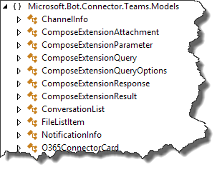
Events and Queries
Activity payload
Type is invoke
Name identifies type of event
composeExtension/query
composeExtension/querySettingUrl
composeExtension/setting
Sent to registered bot endpoint
Teams Connector NuGet package provides detection methods and data models

Slide 4
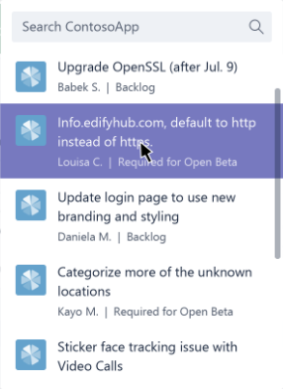
Events and Queries
Query events
Query data sent to bot
Activity.GetComposeExtensionQueryData()
Verify commandId and parameters
Use parameter value to query your service
Respond with attachment layout of “List”
Adaptive Card
Hero Card
Thumbnail Card
O365Connector Card

Slide 5
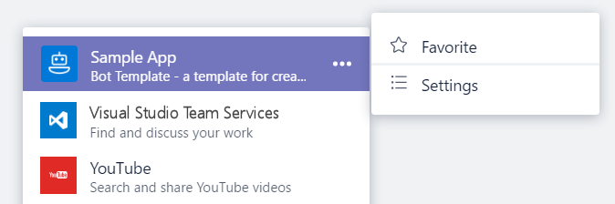
Events and Queries
Settings events
If canUpdateConfiguration is true, Teams will send Settings events in response to user action
onQuerySettingsUrl
Sent when “Settings” clicked
Return Url of settings page
Teams will render page
onSettingsUpdate
Sent when settings page is closed
Storage of settings is developer responsibility

Slide 6
Responding to User Requests
Service must respond within 5 seconds.
Response is not an activity sent via the Bot Framework.
Response is an HTTP Response:
HTTP Status of 200
Content type application/json
Response body must contain a valid composeExtension object.

Slide 7
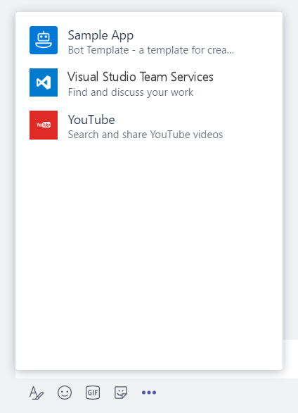
Message Extensions in App Manifest
"composeExtensions": [ { "botId": "[MicrosoftAppId]", "scopes": [ "team" ], "canUpdateConfiguration": true, "commands": [ { "id": "searchCmd", "description": "Search Bot Channels", "title": "Bot Channels", "initialRun": false, "parameters": [ { "name": "searchText", "description": "Enter your search text", "title": "Search Text“ } ] } ] } ]
composeExtension node
Associated with a registered application
Personal and Team scopes
Define command UI and parameter
Multiple extensions
Your extension shown along with all others added to Teams
Notes:
commandExtension is part of the manifest.json file
Scope determines if 1:1 (personal) or channel (team)

Slide 8
Demo Messaging Extension

Slide 9

Summary
Events and Queries
Responding to User Requests
Message Extensions in App Manifest

Slide 10
Thank you

